Slide 1



Airtel Postpaid for <Customer name>
Sub headline

Slide 2


Working from home, remotely or
on-the-go has become a part of our daily life..
Hybrid and Remote working requirements has created increased need for
Stronger Indoor / Outdoor Coverage
More Mobile Data
To ensure seamless calls & internet connectivity in both densely populated as well as remote locations
Surplus mobile internet to accommodate higher data usage in today’s highly digital workspaces
Airtel ensures a Premium Experience...

Slide 3











Why Corporate Postpaid?
STRONG NETWORK
EXCLUSIVE BENEFITS
GREAT SERVICE
First to launch 5G services in India
Retain contact numbers
Dedicated Relationship Manager
100% Network assurance
Save 18% GST on total rental
Airtel Thanks for Business
Trace Mate
Facility
Dedicated
Account
Helpline
Connectivity on the Go | Mi-Fi Devices
Customize Hello Tunes
Dedicated
email support system

Slide 4

Say hello to Airtel 5G Plus!

Slide 5






Experience the power of 5G
Why choose Airtel 5G Plus?
Use of 5G technology
with widest ecosystem
Networking Slicing
for differential quality needs
Most energy efficient
eco-friendly technology
Discover what Airtel 5G Plus has to offer
Superfast Speeds
Upload and download heavy files in an instant
Widest technology acceptance
All 5G smartphones in India will work on Airtel 5G Plus
No lag video calls
High-quality streaming even on the go
Airtel 5G Plus service is now available in many cities across India.

Slide 6







Airtel Network Advantage – Widest range of spectrum
1.5lac 5G
sites across India.
First operator to rollout 5G network. Live across India.
Advantage
Enjoy 100% network assurance across all circles/ states through single spoke
We serve
8 Million corporate postpaid customers
How will this benefit you?
Improved indoor/ outdoor coverage
Better video calls experience
Up to 30X faster download

Slide 7
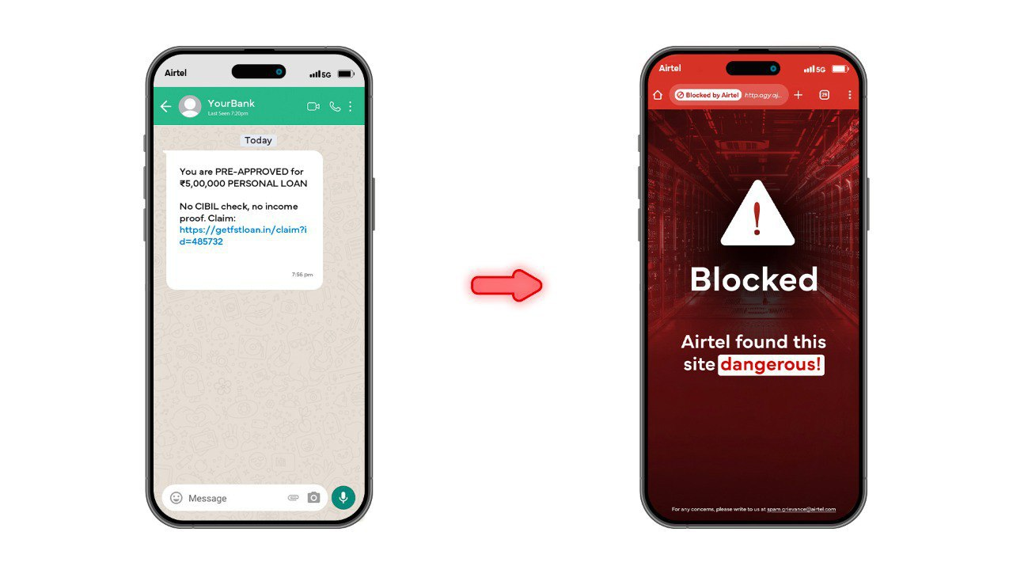
Airtel - The Safe Network
We’ve protected you from spam calls and SMS, now, we’re stepping up with real-time fraud, phishing attack and malicious link protection!
Airtel’s Solve
1
Airtel has introduced an AI-powered Fraud Detection solution that detects and blocks phishing attacks and malicious links in real time across browsers, emails, and apps like WhatsApp, Instagram, and Telegram to protect your company data.
2
Seamlessly built into Airtel’s network: No apps, no tools, no setup. Automatically protects all enterprise users.
Airtel is now the only telco in India offering intelligent link protection at the network level

Slide 8


Airtel advantage with Perplexity Pro AI
Empower your teams to work smarter, faster and more efficiently with Perplexity Pro AI, one of the world’s most advanced AI platforms
Key benefits to your business with Perplexity Pro AI
1
Deep dive with thousands of Pro searches
2
Analyze complex files, PDFs and receive instant summaries
3
Access verified information with real-time citations from trusted sources
4
Choose from the most advanced AI models available like GPT4.1, Gemini, Claude
Corporate Plans will include a 12-month subscription of Perplexity Pro AI worth 17,000 for a year at no extra cost

Slide 9


Corporate Postpaid Plans offer unmatched value
MOBILE PLANS
Monthly rental | ₹349 | ₹399 | ₹449 | ₹549 | ₹1649
Data | 30 GB | 40 GB | 60 GB | 100 GB | 500 GB
Voice | Unlimited | Unlimited | Unlimited | Unlimited | Unlimited
BUSINESS BENEFITS
Tracemate | -- | ✔ | ✔ | ✔ | ✔
Airtel Call Manager | ✔ | ✔ | ✔ | ✔ | ✔

Slide 10

Loads of Data for unmatched experience
‘Stepped-up’ postpaid plans with more data every month
Plan / Data | 349 | 399 | 449 | 549 | 1649
Data | 30 GB | 40 GB | 60 GB | 100 GB | 500 GB
Never lose unused data with Data Rollover*
How it works?
80
GB
100
GB
180
GB
+
=
Previous month’s unused allowance
Current month’s data allowance
Total data available for the current month
*Applicable on Specific Plans | Plan DOWNGRADE leads to LOSS of Accumulated Data

Slide 11



Our plans are affordable
Save 18% GST on total rental
Pocket-friendly plans with 18% GST input credit
Lower starting price
Our plans starting from 349 compared to standard market norm of 399 for better affordability

Slide 12

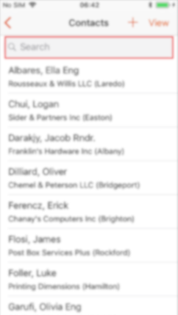
And exclusive features..
Retain contact numbers
Keep the numbers even when employee has moved on, making it easier to maintain valuable touchpoints without any worry of security breach.
Customize Hello Tunes
Add your company tune, slogan or message to increase brand awareness and visibility

Slide 13


And exclusive Corporate Benefits
Dynamic Data Pool
Aggregate all data purchases at an account level and offer employees the complete pool irrespective of individual limits.
Trace Mate Facility
Enhance productivity with this tool to easily track your manpower.
Mi-fi
Experience fast and uninterrupted internet with this Airtel 4G Hotspot. Surf the Internet and stay connected wherever you are.

Slide 14

Superior experience
Dedicated Relationship Manager
Get your queries resolved faster and more efficiently with dedicated helpline, email and an account relationship manager
Airtel Thanks for Business
Easily access a consolidated view of your account for simplified operations and address your requests online

Slide 15



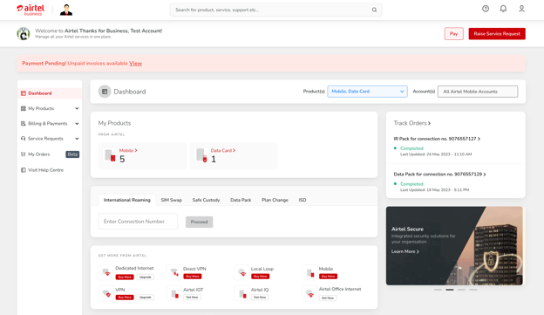





Manage your account with ease – Airtel Thanks for Business
Pay your bill
Raise and Track Service Requests
Swap SIM for your Postpaid Connection
Activate Safe Custody and ISD
Plan Upgrades along with Data Packs activation
User Management (AS/CC details update)
Activate international Roaming & Auto Renewal of IR Packs

Slide 16
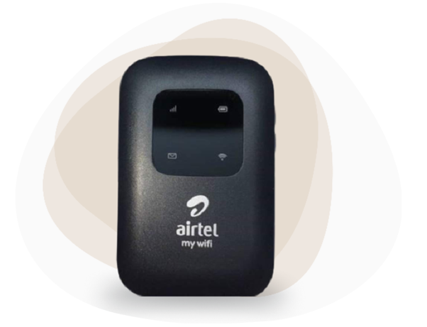




More Data For On-the-Go
My WiFi - 4G Hotspot
Convert any smart device to 4G
Portable, easy to carry
Stay connected for
6hrs without recharging
Connect multiple users
Rental (Rs) | Data benefit (w/o FOC Device) | Data benefit (with FOC Device)
299 | 30GB | 30GB
399 | 85GB | 60GB
499 | 125GB | 100GB
24 months lock-in
Data rollover applicable on base plan
Unlimited data @ throttle speed post consumption of base data

Slide 17



Porting to Airtel Postpaid is now easy
Always stay connected even when you switch with ‘No Downtime’
Sim delivery at your doorstep
Dedicated helpline to help you switch without any hassles

Slide 18


Facilitated seamless connections
between banking platforms and their customers
The Challenges
Airtel Solution
In banks when an employee leaves the organization, leads are passed to the competitors.
Offered facility to keep the number constant and assign the contact number of customers to their new resource.
Helped in operational continuity and maintaining relationship.
Superior customer experience
Improved cost efficiency
Higher security and confidentiality

Slide 19



Resource tracking facility for
a home service management company
The Challenges
Airtel Solution
Employees misrepresenting their departure from the office for client meetings and failing to arrive at the customers' location.
Offered tracking facility gives edge to company coordinators to have a access where they can track location of their resource over the utility.
Helped in performance evaluation
Improved productivity
Enhanced accountability and time management
Higher security and safety

Slide 20


Airtel International Roaming for your business

Slide 21








What Do You Get With Airtel International Roaming?
Highest coverage – one pack works across 184 country
Unlimited data (with FUP throttle)
Enjoy flexibility in travel dates, with pack activating only upon arrival
Free incoming SMS while in roaming
Roam Without Fear of bill shock - No unexpected charges.
24x7 tollfree and WhatsApp support (99100 99100)
Tie-ups with multiple service providers for amazing network coverage

Slide 22


Complete connectivity for all your needs
1 Day
10 Days
30 Days
90 Days
365 Days
₹ 649
₹ 2999
₹ 3999
₹ 5999
₹ 14999
Unlimited Data*
(500 MB high-speed)
100 mins
Unlimited Data*
(5 GB high-speed)
100 mins/day
Unlimited Data*
(12 GB high-speed)
100 mins/day
Unlimited Data*
(2 GB high-speed)
900 mins
Unlimited Data*
(15 GB high-speed)
3000 mins
ONE World, ONE Pack
Covers USA, Europe, Gulf, South Asia, Africa, Australia & more
Differential benefits apply in Africa, Maldives and Caribbean Islands, visit Airtel.in/ir for details
* Voice (OG – Local or local to India + IC)
Data – High speed data based on pack + throttle @ 80kbps post consumption of high speed data
All these packs cover 184 countries, respective benefits will be credited based on the country you travel.

Slide 23



Want To Stay Connected On Personal Trip Abroad?
Pre-Payment Option For IR Pack on Corporate Number
Pre-Paid IR Packs
Key features
Simplified Recharge process via Airtel Thanks App
Upfront payment by COCP user; no recurring on monthly bill
Data and voice top-ups as and when required while in roaming
Pack usage tracking via Thanks App
Coverage across 180+ countries
24*7 Customer Support
International Roaming Pack
IR Data/Voice Add-Ons
Rs 649
500MB, 100 Mins, 10 SMS,
1 Day Validity
Rs 755
1 GB Data,
5 Days Validity
Rs 2999
5GB, 1000 Mins, 20 SMS,
10 Days Validity
Rs 756
100 Mins,
5 Days Validity
Rs 3999
12GB, 3000 Mins, 20 SMS,
30 Days Validity
Note:
Minutes include IN + OG (Local + IN)
Prices mentioned above are excluding GST
Post consumption of data/voice/SMS benefits, further respective usages would be blocked

Slide 24
Now Stay Connected, Even In the Skies
Airtel In-Flight Roaming Packs
In-flight Roaming Packs
Key features
Applicable on selected 19 international airlines & selected Fleets
Free incoming SMS
Validity of 24 hours
Applicable for interconnecting flights within validity
No incoming calls, only outgoing
Data is on 3G
For bundled benefits
Includes 195 rental benefits
Standalone
Bundled With Existing IR Packs
Rs 195
250MB, 100 Mins, 100 SMS
Rs 3999
250MB, 100 Mins, 100 SMS
Rs 295
500MB, 100 Mins, 100 SMS
Rs 5999
250MB, 100 Mins, 100 SMS
Rs 595
1GB, 100 Mins, 100 SMS
Rs 14999
250MB, 100 Mins, 100 SMS
INCLUDED AIRLINES
Aer Lingus, Asiana Airlines, Biman Bangladesh Airlines, Cathay Pacific, Egyptair, Emirates, Etihad Airways, Eva Air, Kuwait Airways, Lufthansa, Malaysia Airlines, SAS Scandinavian Airlines, Singapore Airlines, Swiss, Tap Air Portugal, Turkish Airlines, Uzbekistan Airways, Air Belgium, ITA Airways.
Covered flights and fleet annexure mentioned on last slide.
In-flight validity of 24hrs starts from the time of pack activation

Slide 25

Airtel World pass: That’s the smarter choice
Customer travelling to US via Dubai layover
Local Sim: $40
(AT&T – 15GB)
Dubai Rs 649
1day Pack
Call back to India (5min/day)
$15
= 5136
28% more expensive
Airtel
Travel Sim
Local SIM
One pack for the world
(Layover locations covered)
Financial & other imp alerts
Usage Tracking
No Extra Documents
Saving on ISD
Multiple Tie-ups
with local operator

Slide 26
Competition : 60% expensive, Covers 40% of the world
Airtel
Competition
Plan for 30 days
Rs 3999
Rs 6427
(Rs 5999 for 28 days)
60% more expensive
Countries covered
184
81
Top destination like Maldives not covered
Usage Tracking
Flexibility of travel
Auto-activates
when you land
Have to specify
date of travel
Voice Benefits
100mins/day
(OG+IC)
1500mins
(IC UL)
200% more talktime

Slide 27



Takeaways
1
2
3
Best value packs available with Airtel, don’t have to look for any other option
Great flexibility, buy now and pack gets Auto Activated when you land
Packs available for all your needs, from 1 day quick meetings to 1 year for on-site employees

Slide 28
Thank you

